Slide 1


End-to-End Learning of Communication System without Known Channel
Hao Jiang, Linglong Dai
Department of Electronic Engineering
Tsinghua University
June, 2021
Notes:
Hello everyone, today I am very glad to introduce our work in ICC. My name is Hao Jiang, comes from Department of Electronic Engineering, Tsinghua University. Today, the title of my speech is End-to-End Learning of Communication System without Known Channel. Leveraging powerful deep learning techniques, the end-to-end (E2E) learning of communication system is able to outperform the classical communication system. Unfortunately, this communication system cannot be trained by deep learning without known channel. To deal with this problem, a generative adversarial network (GAN) based training scheme has been proposed to imitate the real channel. However, the gradient vanishing and overfitting problems of GAN will result in the serious performance degradation. To mitigate these two problems, this paper proposes a residual aided GAN (RA-GAN) based training scheme. Simulation results show that the trained residual generator has better generation performance than conventional generator, and the proposed RAGAN based training scheme can achieve the near-optimal performance.

Slide 2
Background
Existing methods
RA-GAN based training scheme
Simulation results
Conclusions
Notes:
My speech includes five parts: background, existing methods, RA-GAN based training scheme, simulation results, and conclusions. At first, let me introduce the background.

Slide 3
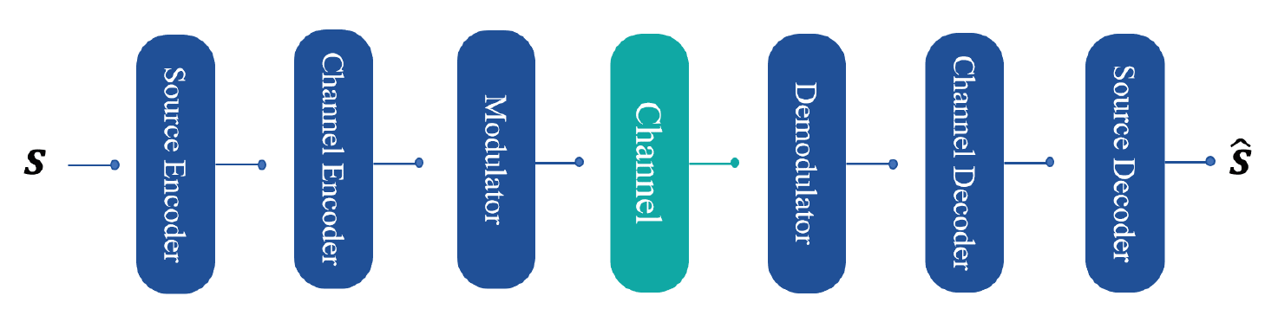
Background
Problem in current communication system
  The optimization of each module doesn’t mean the global optimization of the whole system
  The non-linear effecting is difficult to be described by mathematical model
Optimal demodulator
Optimal detection
Optimal decoder
Optimal system
False！
Notes:
In the history of wireless communications developed from 1G to 5G, the fundamental wireless system design paradigm remains unchanged, i.e., the whole complicated wireless system an be divided into multiple simpler individual modules, such as source encoder, channel encoder, modulator, demodulator, channel decoder, source decoder, etc [1]. However, the optimization of each module doesn’t mean the global optimization of the whole system [2], e.g., the separate design of modulation and coding is known to be sub-optimal [3]. Thus, such a classical design paradigm becomes the bottleneck that limits the globally optimal performance of the wireless communication system.

Slide 4
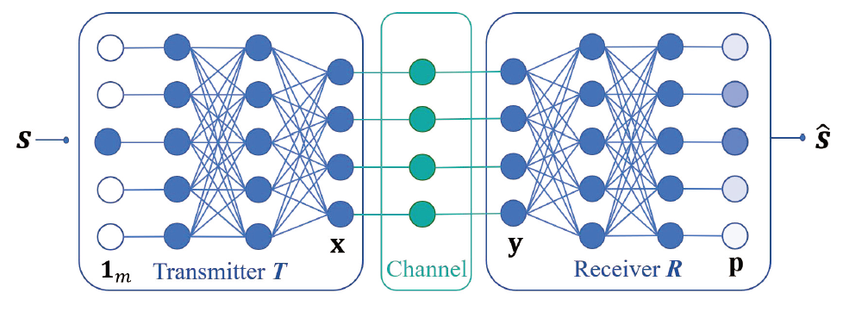
Background
Main idea
  The communication system is regarded as a neural network, and the joint optimization is carried out with the goal of global optimization
  Breaking the modular design
[Shea’17] T. J. O’Shea and J. Hoydis, “An introduction to deep learning for the physical layer,” IEEE Trans. Cogn. Commun. Netw., vol. 3,
no. 4, pp. 563–575, Dec. 2017.
Notes:
To break through this bottleneck, the paradigm of end-to-end (E2E) learning of communication system has been recently proposed to jointly optimize the whole system by leveraging deep learning techniques [2], [4]. It is well known that deep learning is usually realized by using multi-layer neural network (NN), in which the adjacent layers are connected by trainable weights. For the E2E learning of communication system, the transmitter and receiver are constructed by multilayer NNs, both of which are trained by the standard back propagation (BP) algorithm to update the weights. Thus, the E2E learning of communication system could reach or even outperform the conventional.

Slide 5
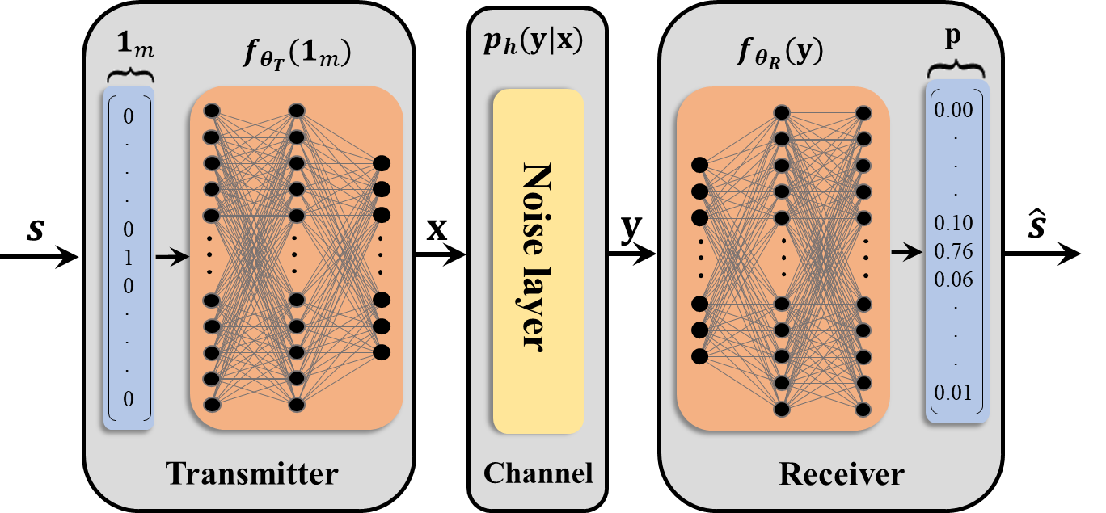

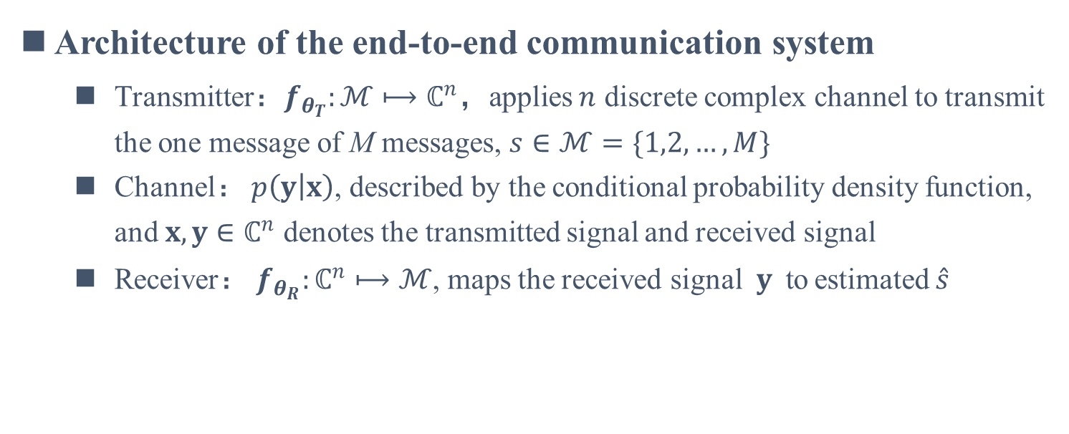
End-to-End Learning of Communication System
Architecture of the end-to-end communication system
  Transmitter$：f_{θ_{T}}:ℳ⟼ℂ^{n}$，applies $n$ discrete complex channel to transmit the one message of M messages, $s∈ℳ=\{1,2,…,M\}$
  Channel： $p\left(y | x\right)$, described by the conditional probability density function, and $x,y∈ℂ^{n}$ denotes the transmitted signal and received signal
  Receiver： $f_{θ_{R}}:ℂ^{n}⟼ℳ$, maps the received signal$y$to estimated $\hat{s}$
k bit
Choose maximum probability
M-d input
n
channel
n-d
vector
[Shea’17] T. J. O’Shea and J. Hoydis, “An introduction to deep learning for the physical layer,” IEEE Trans. Cogn. Commun. Netw., vol. 3,
no. 4, pp. 563–575, Dec. 2017.
Notes:
The architecture of E2E learning of communication systems is shown in Fig. 1, which is composed of three parts: transmitter, channel, and receiver. Both transmitter T and receiver R are implemented by multi-layer NNs, with the trainable weights denoted by T and R, respectively.

Slide 6

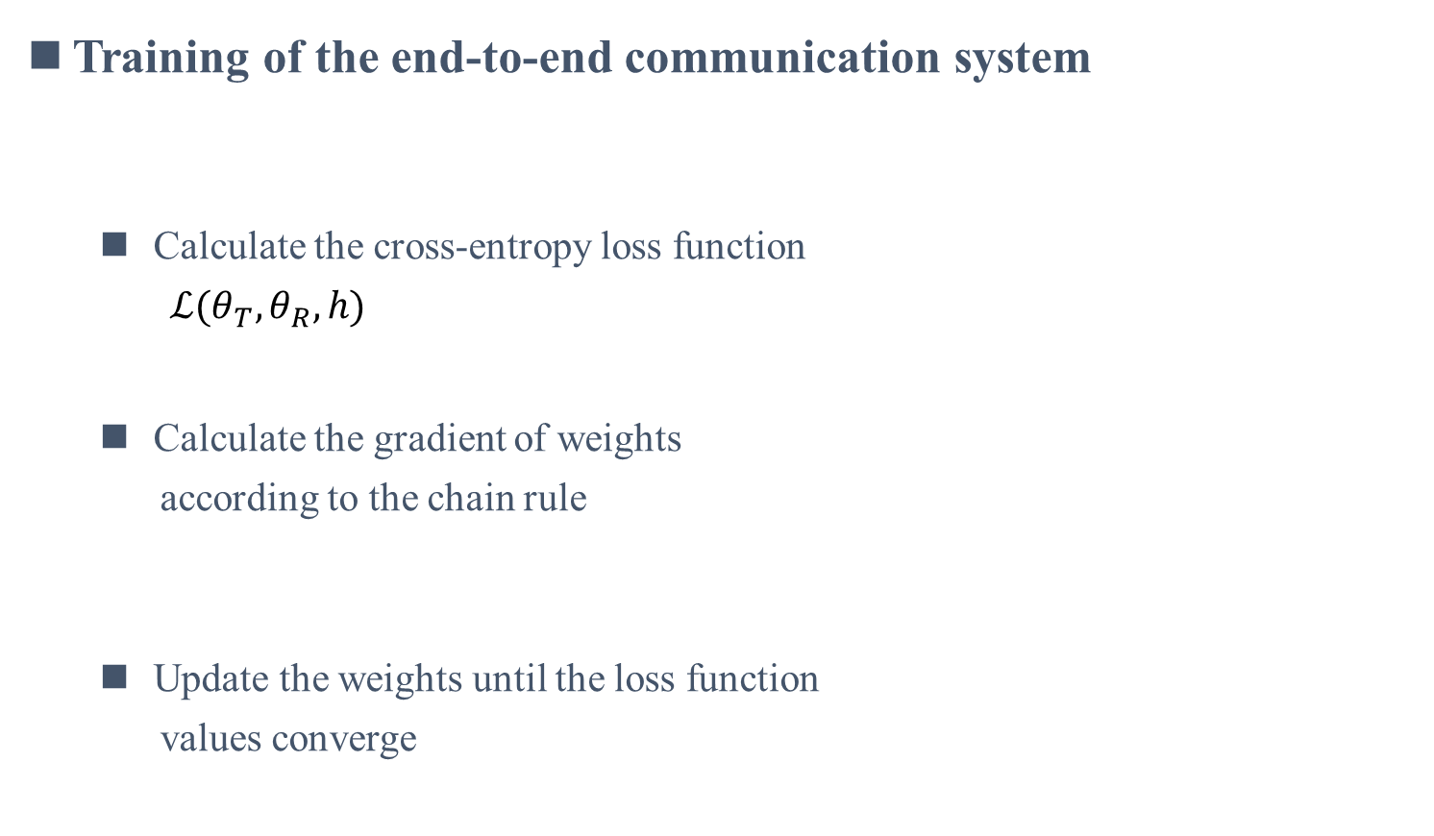
End-to-End Learning of Communication System
Training of the end-to-end communication system
  Calculate the cross-entropy loss function
  $ℒ(θ_{T},θ_{R},h)$
  Calculate the gradient of weights
  according to the chain rule
  Update the weights until the loss function
  values converge
$$y=hx+w, h∈ℂ and x,y,w∈ℂ^{n}$$
[Shea’17] T. J. O’Shea and J. Hoydis, “An introduction to deep learning for the physical layer,” IEEE Trans. Cogn. Commun. Netw., vol. 3,
no. 4, pp. 563–575, Dec. 2017.
Notes:
Next, let me introduce the training process of the end-to-end communication system; We consider a slow fading channel with continuous N time slots, 𝐲= hx + n.
Frist, we calculate the cross-entropy loss function between the one-hot vector and probability vector, and then the gradients of the receiver and transmitter weights are calculated according to the chain rule. Finally, the weights are updated using gradient descent algorithm. The training process will stop until the loss function stops falling or the number of iterations reaches the maximum.

Slide 7
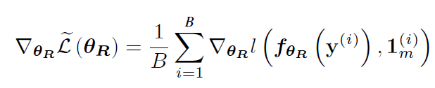

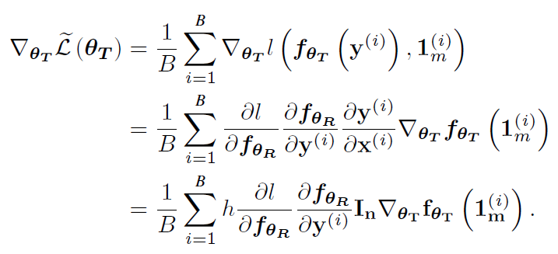
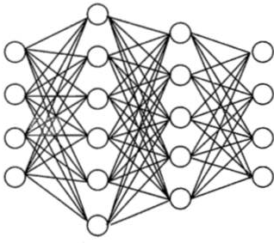
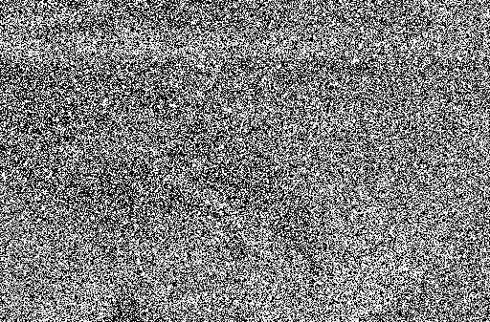



End-to-End Learning of Communication System
Problem and challenge
  The gradient is unavailable in transmitter due to the unknown channel
Receiver R
Transmitter T
Unknown channel
$$x$$
$$s$$
Transmitter
Channel
Receiver
$$\hat{s}$$
[Ye’19] Ye, Hao, et al. “Deep Learning based End-to-End Wireless Communication Systems with Conditional GAN as Unknown
Channel,” IEEE Trans. Wireless Commun., vol. 19, no. 5, pp. 3133–3143, May 2020.
Notes:
However, with the guaranteeing of the performance, the E2E learning of communication system faces some challenging, one of these is that the transmitter cannot be trained by the BP algorithm without known channel.
Specifically, according to the chain rule, the gradient of the receiver can be calculated according to the loss function calculated by the receiver. For the transmitter, however, if we expand the chain rule, the presence of an unknown channel h, leading to a transmitter can't get the gradient, that is to say, the gradient cannot be returned to the transmitter and update the parameters Led to the end-to-end cannot achieve transceiver joint optimization of this introduction of end-to-end system of the initial target

Slide 8
Background
Existing methods
RA-GAN based training scheme
Simulation results
Conclusions
Notes:
Next, let's talk about how some of the existing work address this problem

Slide 9





E2E communication system with unknown channel
Relevant research
  Existing solutions：Reinforcement Learning (RL), the transmitter is optimized by gradient strategy
  Disadvantages: The channel cannot be too complex; A large number of loss values are fed back to train the transmitter
State
Action
Environment
$$x$$
$$y$$
$$s$$
Transmitter
Channel
Receiver
$$\hat{s}$$
Reward
  $$ℒ(θ_{T},θ_{R},h)$$
[Aoudia’19] F. A. Aoudia and J. Hoydis, “Model-free training of end-to-end communication systems,” IEEE J. Sel. Areas Commun.,
vol. 37, no. 11, pp. 2503–2516, Nov. 2019.
Notes:
To overcome this limitation, researchers proposed to use reinforcement learning to solve the problem that the transmitters could not be trained. The basic idea is to regard the transmitter as the robot, the input information S as the state of the transmitter, the channel and receiver as the environment of the robot, and the symbol X output by the transmitter as the action of the robot. According to the feedback loss function value L as reward, the transmitter updates its parameters with the policy gradient.
However, this method assumes that the channel should not be too complex and the receiver needs to feed back a large number of loss value.

Slide 10




E2E communication system with unknown channel
Relevant research
  Existing solutions：Generative Adversarial Network (GAN), Simulate channel behavior
  Disadvantages: The training process is unstable: gradient vanishing and overfitting are serious problems
$$x$$
$$\tilde{y}$$
$$s$$
Transmitter
Generator
Receiver
$$\hat{s}$$
Discriminator
Channel
[Ye’19] H. Ye, L. Liang, G. Y. Li, and B. Juang, “Deep learning-based end-to-end wireless communication systems with
conditional GANs as unknown channels,” IEEE Trans. Wireless Commun., vol. 19, no. 5, pp. 3133–3143, May 2020.
Notes:
Therefore, the researchers propose to use generative adversarial network to solve the problem that the transmitter cannot be trained. This method can simulate the behavior of any channel, and can replace the feedback of a large number of loss by the way of feedback surrogate gradient.
Specifically, a network of generators and discriminators are added, in which the discriminator network distinguishes the real received signal and the fake received signal generated by the generator, and the generator network generates fake received channel and expects to trick the discriminator into making the wrong behavior. Both of them take this as the goal to train their network parameters.
Therefore, the trained generator can achieve reliable feedback of the gradient (animation), as shown in the lower right equation, is the chain rule expansion of the gradient of the transmitter parameters through the generator.
However, there is always the problem of training instability in generative adversarial network. In the training process of introducing end-to-end system, on the one hand, the multi-layer generator will cause the phenomenon of gradient vanishing, and the optimization of many weights of multiple modules will also produce the problem of overfitting.

Slide 11
Background
Existing methods
RA-GAN based training scheme
Simulation results
Conclusions
Notes:
Next, I will introduce our work in how solve the gradient vanishing and overfitting problem.

Slide 12








RA-GAN based training scheme
Solution
  Loss function: Introduce regular term to solve overfitting
  Generator: Introduce residual learning to solve gradient vanishing
New loss function
Original loss function
Nework weight
$f_{θ_{G}}$(x))
$$transmitted signal x$$
$$generated signal \tilde{y}$$
$$conventional generator$$
$f_{θ_{G}^{R}}$(x))
$$transmitted$$
$$signal x$$
$$generated$$
$$signal \tilde{y}$$
$$residual generator$$
Notes:
In order to deal with the above challenges, a generative adversarial network based on residual aided is proposed. First of all, in order to solve the overfitting problem, we add a regular term to the loss function to effectively limit the network representation capacity, where R,T,G and D represent receiver, transmitter, generator and discriminator respectively. In addition, we introduce the residual learning, the input and output of the generator are connected by the skip connection, as shown in the left lower figure, makes the goal the generator is to learn the difference between the receiving signal and transmitting, which makes the gradient magnitude of feedback to the transmitters have greatly enhanced, as shown in the lower right type, compared with using traditional generator gradient formula of the chain rule, the residual generator have one more item, this is due to a new connection of transmitter gradient.

Slide 13
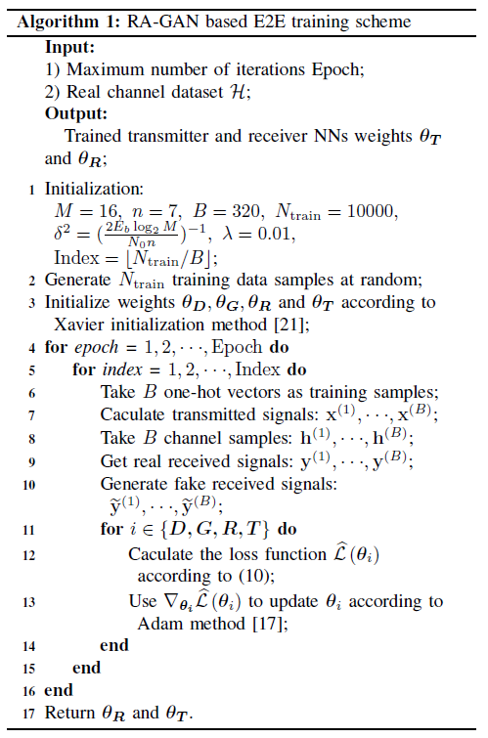
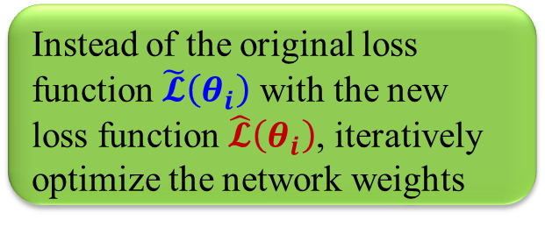
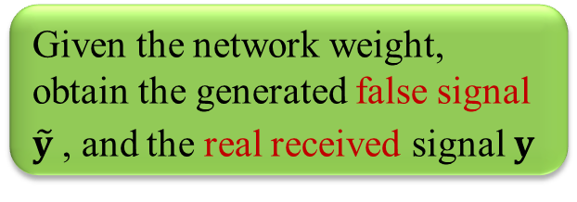
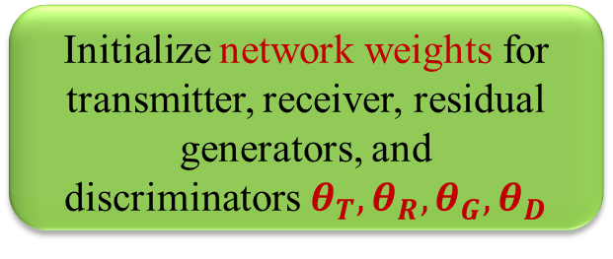
RA-GAN based training scheme
Algorithm
Initialize network weights for transmitter, receiver, residual generators, and discriminators${{ θ}_{T},θ}_{R},θ_{G},θ_{D}$
Given the network weight, obtain the generated false signal $\tilde{y}$, and the real received signal $y$
Instead of the original loss function $\tilde{𝓛}\left(θ_{i}\right)$ with the new loss function $\hat{𝓛}\left(θ_{i}\right)$, iteratively optimize the network weights
Notes:
Here is the specific process of the method; Roughly divided into three step, initialization weights, generating fake and real signal, iteratively training the network weights.
It needs to be emphasized that the transmitter, receiver, generator and discriminator adopt iterative training, that is, when the parameters of one module are updated, the parameters of the other modules remain unchanged until convergence, and then the actual information transmission can be carried out by returning the parameters of the transmitter and receiver.

Slide 14
Background
Existing methods
RA-GAN based training scheme
Simulation results
Conclusions
Notes:
Next, we will introduce our simulation results.

Slide 15
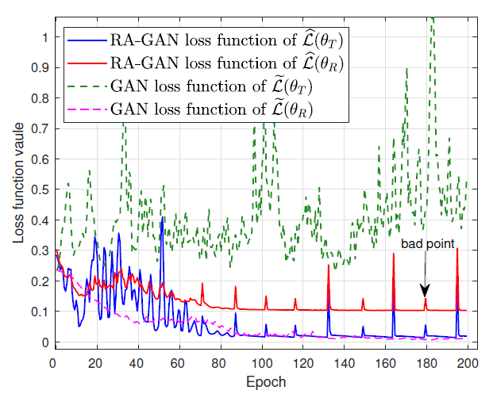
Simulation result
Simulation result
  Channel: Additive white Gaussian noise (AWGN) channel
  Number of modulation bits: k=4, number of discrete channels: n=7
Proposed Residual-Aided GAN
Conventional GAN
Residual generator has better generation performance than traditional generator
Notes:
Now let's look at the simulation results; We consider AWGN channel, modulation bit number k=4, channel number n=7 scenario; We compare the generation performance of the traditional generator and the proposed residual generator. Since the goal of introducing the generating network is to use the generator to generate fake signal as similar to the real received signal as possible, if this goal is true, then the loss value of the fake signal shall be consistent and close to the loss calculated by the received signal through the real channel.
As shown in the figure below, the red line and blue line represent the curve of the two loss using the mentioned RA-GaN with the number of iterations, while the green line and pink line represent the curve of loss based on the traditional generator with the number of iterations. It can be seen from the figure that the trend of the two losses based on the mentioned RA-GAN is closer, while the traditional generator does not show such a trend, which is caused by the gradient vanishing and overfitting.

Slide 16
Simulation result
Simulation result
BLER performance comparison in AWGN channel
BLER performance comparison in the Rayleigh fading channel
The proposed Residual-Aided GAN
The use of residual generators and variable loss functions can greatly improve performance
Notes:
Further, we show performance comparisons between different training methods of BLERS in the AWGN channel and Rayleigh channel.
Among them, the red line is the RA-GAN method proposed by us, the blue line is the traditional GaN method, the green line is the training method based on reinforcement learning, and the black dotted line is the training results that assume the channel is perfectly known. It can be seen that the training method based on the proposed RA-GaN can obtain the performance that is closest to the optimal result. However, the training method based on traditional GaN does not get good results, which is also due to the influence of gradient vanishing and overfitting.

Slide 17
Background
Existing methods
RA-GAN based training scheme
Simulation results
Conclusions
Notes:
Final, we will give the conclusion

Slide 18
Conclusions
Problem and challenge
  The optimization of each module doesn’t guarantee global optimization.
  E2E learning of communication system jointly optimizes the transmitter and receiver.
  However, the gradient can not be calculated in transmitter without known channel.
Training the transmitter without known channel
  The GAN based training scheme results in the problem of gradient vanishing and overfitting.
  The regular term is introduced in loss function to solve the overfitting problem.
  Introduces residual learning to solve gradient vanishing problem.
  Simulations shows the RA-GAN based training scheme can achieve near-optimal performance.
Notes:
We first introduce the E2E learning of communication system and the challenge of this system. One of them is that the transmitter can not be trained without known channel. To solve this problem, we propose the RA-GAN based training scheme to improve the GAN based training scheme. Specifically, we improved the surrogate gradient method with residual learning so as to transform the conventional GAN into RA-GAN. Based on the proposed RA-GAN based training scheme, more powerful and robust gradients can be achieved to solve the gradient vanishing problem. Furthermore, regularizer was utilized in the RA-GAN to limit the representation ability, which is able to solve the overfitting problem. Simulation results verified the near-optimal BLER performance of the proposed RA-GAN based training scheme, which outperforms other deep learning methods.

Slide 19
Reference
L. Dai, R. Jiao, F. Adachi, H. V. Poor, and L. Hanzo, “Deep learning for wireless communications: An emerging interdisciplinary paradigm,” IEEE Wireless Commun., vol. 27, no. 4, pp. 133–139, Aug. 2020.
T. O’Shea and J. Hoydis, “An introduction to deep learning for the physical layer,” IEEE Trans. Cogn. Commun. Netw., vol. 3, no. 4, pp. 563–575, Dec. 2017.
E. Zehavi, “8-PSK trellis codes on rayleigh channel,” IEEE Trans. Commun., vol. 40, no. 5, pp. 536–540, Oct. 1989.
S. D¨orne, S. Cammerer, J. Hoydis, and S. t. Brink, “Deep learning based communication over the air,” IEEE J. Sel. Topics Signal Process., vol. 12, no. 1, pp. 132–143, Feb. 2018.
S. Yang and L. Hanzo, “Fifty years of MIMO detection: The road to large-scale MIMOs,” IEEE Commun. Surveys Tuts, vol. 17, no. 4, pp. 1941–1988, 4th Quart. 2015.
X. Wei, C. Hu, and L. Dai, “Deep learning for beamspace channel estimation in millimeter-wave massive mimo systems,” to appear in IEEE Trans. Commun.
H. Ye, G. Ye Li, and B. F. Juang, “Bilinear convolutional auto-encoder based pilot-free end-to-end communication systems,” in Proc. IEEE Int. Conf. on Commun. (IEEE ICC’2020), Jun. 2020, pp. 1–6.
Notes:
Here are the references

Slide 20
Reference
E. Balevi and J. G. Andrews, “Autoencoder-based error correction coding for one-bit quantization,” IEEE Trans. Commun., vol. 68, no. 6, pp. 3440–3451, Jun. 2020.
V. Raj and S. Kalyani, “Backpropagating through the air: Deep learning at physical layer without channel models,” IEEE Commun. Lett., vol. 22, no. 11, pp. 2278–2281, Nov. 2018.
F. A. Aoudia and J. Hoydis, “Model-free training of end-to-end communication systems,” IEEE J. Sel. Areas Commun., vol. 37, no. 11, pp. 2503–2516, Nov. 2019.
R. Fritschek, R. F. Schaefer, and G. Wunder, “Deep learning for channel coding via neural mutual information estimation,” in Proc. IEEE Int. Workshop Signal Process. Adv. Wireless Commun. (IEEE SPAWC’19), Jul. 2019, pp. 1–5.
H. Ye, L. Liang, G. Y. Li, and B. Juang, “Deep learning-based end-to-end wireless communication systems with conditional GANs as unknown channels,” IEEE Trans. Wireless Commun., vol. 19, no. 5, pp. 3133–3143, May 2020.
K. He, X. Zhang, S. Ren, and J. Sun, “Deep residual learning for image recognition,” in Proc. IEEE Conference on Computer Vision and Pattern Recognition (IEEE CVPR’16), Jun. 2016, pp. 770–778.
Notes:
Here are the references

Slide 21

Thank you！
End-to-End Learning of Communication System without Known Channel
Hao Jiang, Linglong Dai
June, 2021
E-mail: jiang-h18@mails.tsinghua.edu.cn
Website: http://oa.ee.tsinghua.edu.cn/dailinglong/
Notes:
Thank you!

